Slide 1

Share it to let it know !
It’s beautiful to make a blog.
But without reader, is it joyous ?
Share it !
Like it !

Slide 2
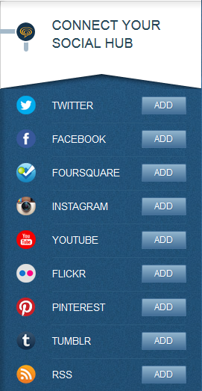
Feed it !
Write a lot of articles bored you ?
You can automatically use your facebook publications.
So let all this people know your personal life.
Just click on the deadly button and take care of your boss.

